Slide 1



How did We Come to Microservices? Definitions Audience: All

Slide 2
Introduction
How did We Come to Microservices?
Who I am: <Instructor Name>
Title
Organization
Role
Background

Slide 3
Agenda
How did We Come to Microservices?
Microservices – History, Driving Forces, and Definition
Microservices Patterns
DevOps
Reactive Microservices
1
5
9
13
AD
All
D
AD
A
Microservices Prerequisites
Integration
Securing Microservices
Testing
2
6
10
14
AD
AD
A
D
A
A
Spring Boot
Migrating Monoliths to Microservices
Domain Driven Design Testing
Scaling Microservices
3
7
11
15
AD
D
A
A
A
Case Study
Cloud
UI
Microservices Anti-Patterns
4
8
12
16
AD
AD
All
All
A
A
Legend: All Developer Advanced Developer Architect
All
D
AD
A

Slide 4

Objectives
How did We Come to Microservices?
At the end of this training, you should be able to:
Define Microservices and their characteristics
Define the microservices journey
List benefits and challenges of microservices

Slide 5
Topics
How did We Come to Microservices?
Definition
Definition Characteristics | Benefits Complexities

Slide 6
What are Microservices?

Slide 7
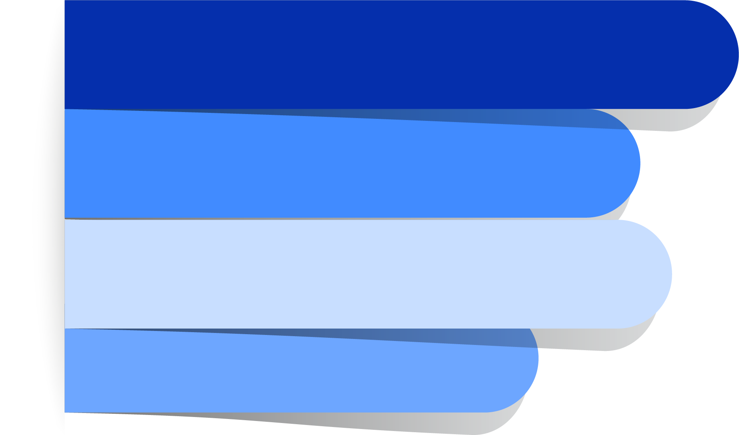
What Are Microservices?
How did We Come to Microservices?
Presently a lot of hype!
Best described as:
An architectural style
An alternative to the more traditional 'monolithic' applications
Decomposition of single system into a suite of small services, each running as independent processes and intercommunicating via open protocols
With all the benefits/risks this implies
Notes:
So what are Microservices anyway? Well at present, there is certainly a lot of industry hype around this topic. Seems like our industry goes through this every few years – a new technology comes out, and it takes several years to sort it out to learn what it is really all about.
Microservices are best described as an architectural style for building applications. The best way to understand this style is to contrast it with something most developers are familiar with; the so-called “monolithic” applications. In fact, I'm going to walk you through a compare / contrast exercise in just a bit.
So microservices are an architectural style where a single application is built as a suite of small services, each of which are running as independent processes, and each of which communicate with the others through open protocols – with all of the benefits and risks this implies.

Slide 8
Definitions from the Experts
How did We Come to Microservices?
Developing a single application as a suite of small services, each running in its own process and communicating with lightweight mechanisms, often an HTTP resource API.
Martin Fowler
Fine-grained SOA
Adrian Cockcroft - Netflix
API – Application Programming Interface
SOA – Service Oriented Architecture
Notes:
The industry experts have provided their definitions for this new term. This first quote is from Martin Fowler, and you can see this is basically the same as what I've just described: single application, built from independently running services, communicating using open, lightweight techniques.
Another great simple description – almost a soundbyte – comes from Adrian Cockroft at Netflix; “fine-grained SOA”. Service Oriented Architecture has been with us for quite a while now; this is taking it down to the application level. However, there are some very important differences which I will point out later.

Slide 9
Microservices: Working Definition
Composing a single application using a suite of small services - rather than a single, monolithic application
Each running as independent processes - not merely modules/components within a single executable
Intercommunicating via open protocols - like HTTP/REST or messaging
How did We Come to Microservices?
Separately written, deployed, scaled, and maintained - potentially in different languages
Services encapsulate business capability - rather than language constructs (classes, packages) as primary way to encapsulate
Services are independently replaceable and upgradable
Notes:
Probably best to go on-record to describe what microservices are NOT.
Microservices are NOT the same as service oriented architecture, though it certainly may seem so at first glance. SOA is about integrating various enterprise applications, microservices are about the design of single applications.
Microservices are certainly not going to be the solution to all of the problems you are facing right now. The truth is there are situations where the microservice approach would introduce serious drawbacks and risks.
And finally, though it is a new buzzword in the industry, microservices are not necessarily new. It is possible to find many cases of existing applications composed of separate, independent, intercommunicating processes, and it is possible that you yourself may be working, or may have worked in the past, on applications that embrace the essence of what microservices are all about.

Slide 10
Microservices are not:
How did We Come to Microservices?
The same as SOA
SOA is about integrating various enterprise applications. Microservices are mainly about decomposing single applications.
A silver bullet
The microservices approach involves drawbacks and risks
New! You may be using Microservices now and not know it!
Notes:
Probably best to go on-record to describe what microservices are NOT.
Microservices are NOT the same as service oriented architecture, though it certainly may seem so at first glance. SOA is about integrating various enterprise applications, microservices are about the design of single applications.
Microservices are certainly not going to be the solution to all of the problems you are facing right now. The truth is there are situations where the microservice approach would introduce serious drawbacks and risks.
And finally, though it is a new buzzword in the industry, microservices are not necessarily new. It is possible to find many cases of existing applications composed of separate, independent, intercommunicating processes, and it is possible that you yourself may be working, or may have worked in the past, on applications that embrace the essence of what microservices are all about.

Slide 11
Journey At a Glance

Slide 12
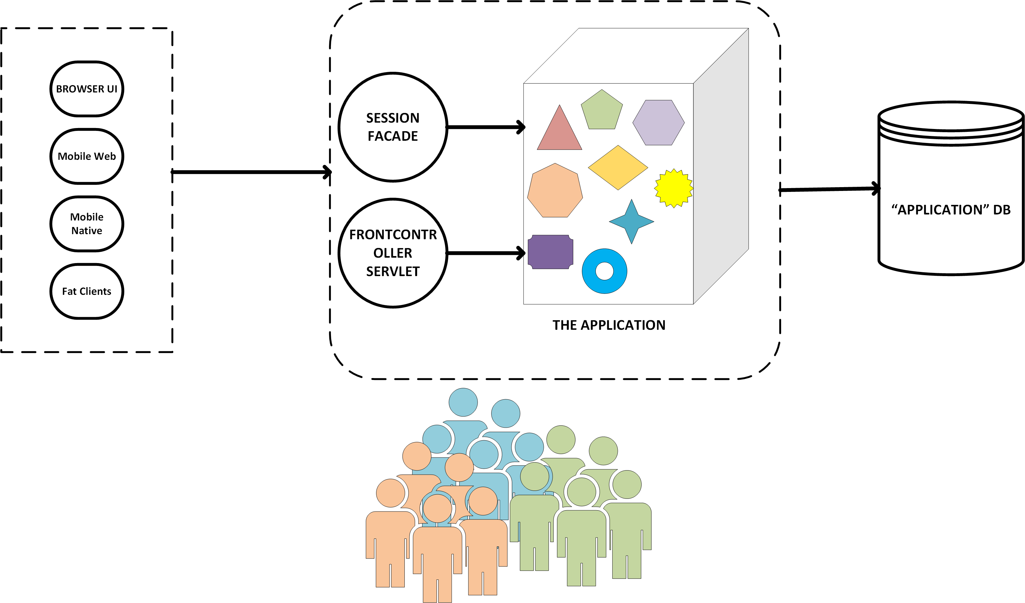
Journey at a glance: Typical Monolith
How did We Come to Microservices?

Slide 13
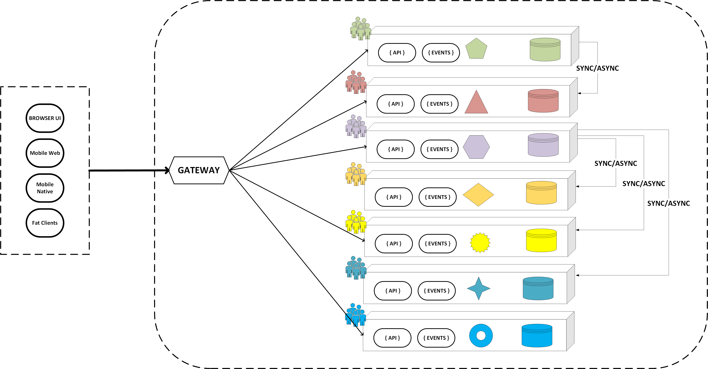
Journey at a glance: Target
How did We Come to Microservices?

Slide 14
A case of Monolith

Slide 15

Microservices: Example
How did We Come to Microservices?
Consider a monolithic shopping cart application that has the following components.
Web/mobile interfaces
Functions for:
Searching for products
Product catalog
Inventory management
Shopping cart
Checkout
Fulfillment
How would this look with Microservices?
Notes:
So lets start by thinking about a traditional shopping cart application. Something with a web interface.
If you stop to think about the functional areas of such an application, you can probably think of several predictable items: we need a way to search for products, we need a way to store all of our products in some kind of catalog, probably in concert with some kind of inventory management. We have to let customers put items into shopping carts and go through a checkout process, and we have to think about order fufillment, and a number of other items that we don't have listed here.
Well how would this look in a microservices style architecture? Well, lets look at how a traditional monolith would look.

Slide 16

Monolithic Application: Example
How did We Come to Microservices?
The following chart displays a Monolithic shopping cart application.
Controllers
Services
DAOs
DB
Notes:
For a monolithic shopping cart application, we would probably take the familiar layer-cake approach backed by a traditional relational database.
We would have data access objects talk to our database to handle persistence, we would have our use-cases implemented by our service layer, and we would have a controller layer serving up traditional web pages to a traditional web browser.
We might have some dynamic JavaScript code on our pages talking to the controllers too, but everything is basically represented by this layered architecture.

Slide 17
Monolithic Application: Example (Continued)
How did We Come to Microservices?
Understanding the Monolithic Architecture
Search
Reviews
Cart
Checkout
Contact
Search
Catalog
Reviews
Cart
Customer
Shipping
Payment
Order
Contact
Product
Inventory
Cart
Customer
Shipping
Payment
Order
Contact
DB
Notes:
Now if you take a closer look at those layers, you can see a lot more detail.
There are many different kinds of controllers for the different pages in the application, like the search page, product review page, cart display, the entire checkout process, and the “contact us” area of the site.
The service layer attempts to model our use-cases, and we probably have separate services to control search functions, catalog management functions, review function, cart functions, and so on.
At the DAO layer, things resemble the data model, and there are typically DAO objects representing each table, or perhaps small group of tables. So we have DAOs for products, inventory, cart, customers, and so on.
And you can expect that within the database, we have various tables setup to support the storage needs for the various parts of the application.
This application structure is well organized and well understood. So why is there a move to something different?

Slide 18


Monolithic Challenges
How did We Come to Microservices?
New types of client applications
Search
Reviews
Cart
Checkout
Contact
Search
Catalog
Reviews
Cart
Customer
Shipping
Payment
Order
Contact
Search
Product
Inventory
Cart
Customer
Shipping
Payment
Order
Contact
DB
Notes:
Well let's start to think about some of the challenges that we are facing at present in the industry.
Ten years ago, we only had to think about web interfaces; but, now we have a proliferation of client technologies. We have smart phones and tablets, we have game consoles and TVs, and now we even have watches and wearables.
The controllers that were designed for our web interface were not designed for these other channels. Plus, we have to think about the different kinds of networks like mobile networks that may be more sensitive to chatty interfaces.

Slide 19




Monolithic Challenges (continued)
How did We Come to Microservices?
New types of persistence/services
Search
Reviews
Cart
Checkout
Contact
Search
Catalog
Reviews
Cart
Customer
Shipping
Payment
Order
Contact
Search
Product
Reviews
Cart
Customer
Shipping
Payment
Order
Contact
DB
Notes:
We also have different types of persistence and back-end technologies to think about.
10 years ago most stored everything in relational databases, and these databases have been a fantastic one-size-fits-all solution for us for many years.
But now we have access to specialized technologies that offer superior performance for many use cases.
For example our product search is much faster and robust with elastic search,
things like product reviews are stored more flexibly in a document store like mongo
The shopping cart is a lot faster and simpler with a key/value store like redis.
Plus we still have needs to access legacy back-end technologies like SAP for orders and shipping, and we might decide it is much easier to let pay-pal handle all of the payments for us.
Now please don't think from this that relational databases are going away – they are still the swiss army knife of storage technology. The point is we are more likely to have a plethora of back-end technologies, and our single application written in a single language will have to stretch a bit to accommodate the various needs.

Slide 20





Monolithic Challenges (continued)
How did We Come to Microservices?
Single Codebase, Deployment, Versioning, and Team Size
Features
Test
Prod
Codebase
continuous
delivery
SCM
SCM – Source Code Management
Notes:
Here is another thing to think about: Our monolithic codebase is a single application, a single codebase. If it is small enough, it is pretty easy for a single team to implement features, manage source using source code management, and test and deploy, hopefully using some kind of continuous delivery pipeline.

Slide 21
Monolithic Challenges (continued)
How did We Come to Microservices?
Single Codebase, Deployment, Versioning, and Team Size
Features
Features
Features
Codebase
Test
Prod
continuous
delivery
SCM
Notes:
But here is the problem: what if the system is large and complex? What if there are large numbers of features that need to be implemented quickly? We'll need a large team, and inevitably we'll have a large codebase. Large teams are hard to manage, and so are large code bases.

Slide 22
Monolithic Challenges (continued)
How did We Come to Microservices?
Features
Features
Flaw discovered during
user acceptance testing
ALL features held up!
Features
Using Teams/Language Constructs
Codebase
Test
Prod
Codebase
Artifact
Codebase
continuous
delivery
SCM
Notes:
...so perhaps what we will do is break our big team down into little teams, each one working on a subset of features, and each one dedicated to maintaining their separate codebase for a single 'module' of a large application – like a JAR. Well this approach might mean that we need to have a separate team in charge of 'assembling' our separate modules into the completed application, and then subjecting the entire thing to our continuous delivery pipeline.
A big problem for all of this is what happens if a flaw is discovered late in the pipeline, such as user-acceptance testing. Now we can't deploy the application until we fix that problem, or at least back it out. Then the problem is that the assembly team is working to try to find the best versions of each team's components to deploy to get the optimal delivery of features delivered. And then they will be putting pressure on the original teams to fix specific issues in specific version of specific modules. So this is a big mess, and most of it has nothing to do with coding, but assembling and deploying.

Slide 23
Understanding a Monolith

Slide 24
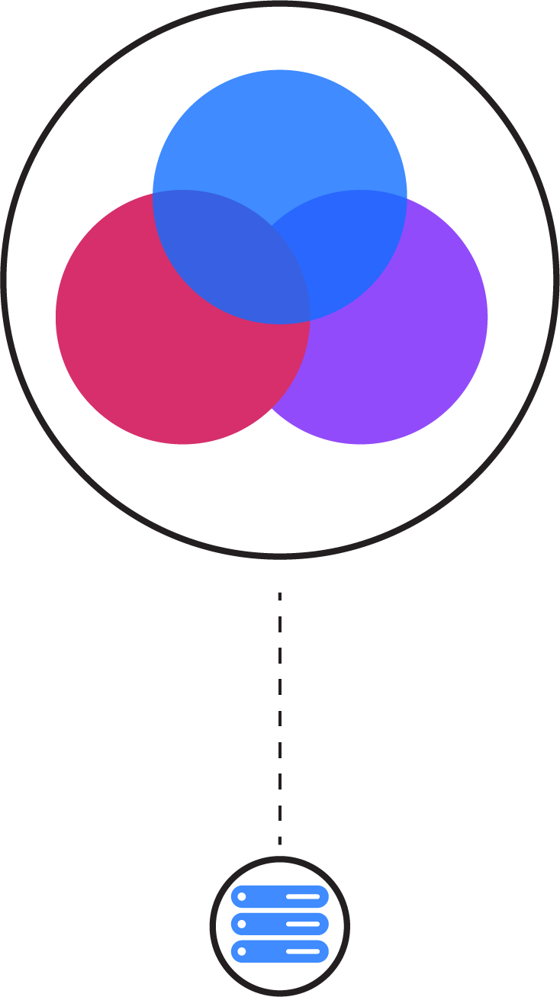
Understanding the Monolithic Implementation
How did We Come to Microservices?
Single application executable
Easy to comprehend, but not to digest
Must be written in a single language
Modularity based on Program Language
Using the constructs available in that language (packages, classes, functions, namespaces, and frameworks)
Various storage/service technologies used
RDBMS, Messaging, Email, and so on
Notes:
So the monolith is a single application executable, and there are advantages and disadvantages to this.
It is actually quite easy to comprehend a single executable – even a large one! After all, the layer-cake diagram I showed a few minutes back was very easy to determine what piece lived where. But it is not easy for any individual developer to digest; there will be code specific to different devices, different storage technologies, and so on, plus potentially millions of lines of code.
Also, we are pretty much committed to working in a single language. If we started in PHP, we need to do everything in PHP. If we did Java, its java from now on. There could be other languages, frameworks, and technologies for any individual piece that works better than what we are committed to.
Next, the ability for us to modularize our application is subject to the capabilities of the language or framework we've chosen. If Java, then it is packages, classes, JARs and WARs. If another technology comes out that suits our needs better, we are stuck.
We also have to make our language and framework of choice work with whatever storage and service technology we are working with. Fortunately in Java we usually have a reasonable alternative for almost everything, but imagine if we had to do some part of our system's work in something like SharePoint – if so .NET would easily be the language of choice. But with a monolith we are stuck with what we are using for the entire application.

Slide 25
Advantages of Monolithic Architecture
How did We Come to Microservices?
Easy to comprehend (but not digest)
Easy to test as a single unit (up to a size limit)
Easy to deploy as a single unit
Easy to manage (up to a size limit)
Easy to manage changes (up to a point)
Easy to scale (when care is taken)
Complexity managed by language constructs
Notes:
So the advantages of monoliths is that they are easy to comprehend, though not digest.
They are also reasonably easy to test as a single unit, at least until they surpass a certain manageable size.
They are also pretty easy to deploy as a single unit; I can deploy version 1.5 of my app as a single WAR file.
They are easy to manage, at least until they get too big, and they are easy to manage, at least to a point.
Scaling is also straightforward. As long as you abide by some basic principles, you can put most web apps behind a load balancer and scale as needed.
Managing complexity is left to the constructs of the language we are using, and we usually have good languages and frameworks for handling this.

Slide 26
Monolithic Drawbacks
How did We Come to Microservices?
Language/Framework lock
Entire app written with single technology stack, cannot experiment/take advantage of emerging technologies
Digestion
Single developer cannot digest a large codebase
Single team cannot manage a single large application
Amazon's ‘2 Pizza’ rule
Deployment as single unit
Cannot independently deploy single change to single component
Changes are “held-hostage” by other changes

Slide 27
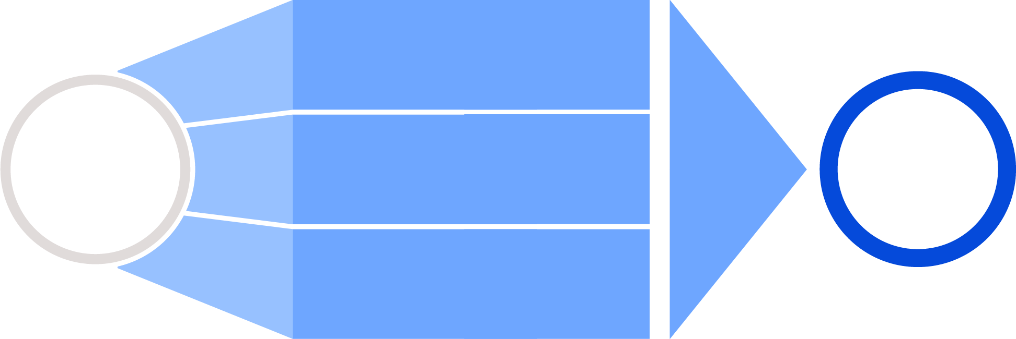
Challenges with Monolith Applications
How did We Come to Microservices?
It is difficult to deploy changes in production quickly, as the team needs to keep track of bugs in hundreds of lines of changing code.
Challenges with large monolith applications
The code becomes too big and complex for the team to understand its flow.
Solutions
Microservices
Varied priorities and schedules for developing features makes it difficult to coordinate tasks in a single release.

Slide 28
Enter Microservices

Slide 29
Enter Microservices Architecture
How did We Come to Microservices?
API Gateway
Reviews
Checkout
Search
Cart
Payment
Shipping
Catalog
Inventory
Contact
Customer
Order
DB

Slide 30
Componentization via Services
How did We Come to Microservices?
NOT language constructs
Where services are small, independently deployable applications
Forces the design of clear interfaces
Changes scoped to their affected service
Reviews
Checkout
Search
Cart
Payment
Shipping
Catalog
Inventory
Contact
Customer
Order

Slide 31
Microservices: Composed using suite of small services
How did We Come to Microservices?
Services are small, independently deployable applications
Not a single codebase
Not (necessarily) a single language/framework
Reviews
Checkout
Search
Cart
Payment
Shipping
Catalog
Inventory
Contact
Customer
Order

Slide 32
Microservices: Communication based on lightweight protocols
How did We Come to Microservices?
HTTP, TCP, UDP, Messaging, and so on
Payloads: JSON, BSON, XML, Protocol Buffers, and so on
Forces the design of clear interfaces
Netflix's Cloud Native Architecture – Communicate via APIs
NOT Common Database
Reviews
Checkout
HTTP
Search
Cart
AMQP
Payment
Shipping
Catalog
TCP
Inventory
Contact
HTTP
Customer
HTTP
AMQP
Order

Slide 33
Microservices: Services encapsulate business capabilities
How did We Come to Microservices?
Not based on technology stack
Vertical slices by business function (for example, cart, catalog, and checkout)
Though, technology chunk also practical (Email service)
Suitable for cross-functional teams
Search
Reviews
Cart
Contact
GET /products?...
GET /reviews/123
POST /reviews
POST /carts
GET /carts/123
POST /carts/123/items
DELETE /carts/123
PUT /carts/123/items/1
DELETE /carts/123/items/1
GET /posts/123
POST /posts

Slide 34
Microservices: Services easily managed
How did We Come to Microservices?
Easy to comprehend, alter, test, version, deploy, manage, overhaul, and replace
By small, cross-functional teams (or even individuals)
Search
Reviews
Cart
Contact
Test
Prod
continuous
delivery

Slide 35


Decentralized Governance
How did We Come to Microservices?
Use the right tool (language, framework) for the job
Services evolve at different speeds and are deployed and managed according to different needs
Make services be “Tolerant Readers”
Consumer-Driven Contracts
Antithesis of ESB (Enterprise Service Bus)
Services are not Orchestrated, but Choreographed

Slide 36
Polyglot Persistence
How did We Come to Microservices?
Freedom to use the best technology for the job:
Don't assume single RDBMS is always best
Very controversial! Many DBAs will not like this!
No pan-enterprise data model
No transactions
Search
Cart
Inventory
Payment
Reviews
Contact
Customer
Order
DB

Slide 37
Microservice Advantages
How did We Come to Microservices?
Easy to digest each service (difficult to comprehend whole)
VERY easy to test, deploy, manage, version, and scale single services
Change cycle decoupled
Easier to scale staff
No Language/Framework lock

Slide 38
Benefits of Microservices Architecture
How did We Come to Microservices?
Isolation
Scalability
Evolutionary
Advantages
Faster Project Development
Productivity
Flexibility

Slide 39
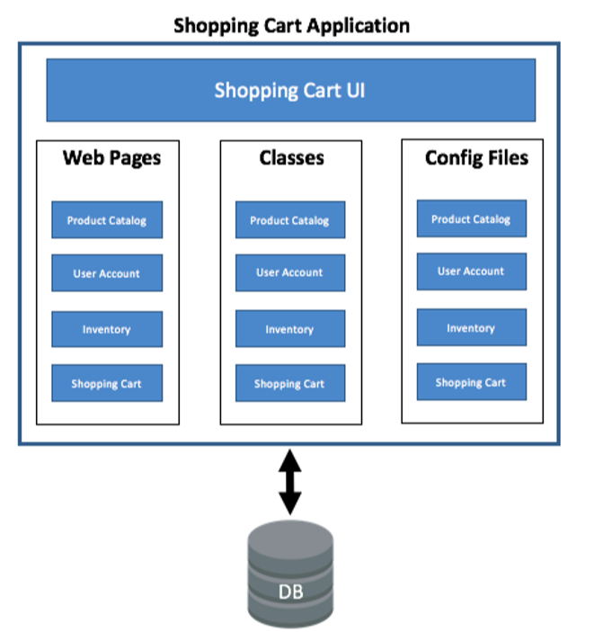
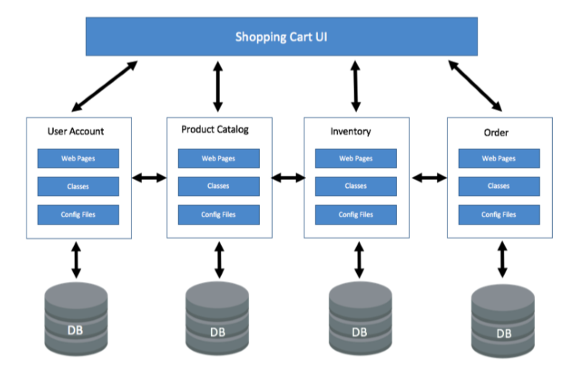
Journey At a Glance: Example
How did We Come to Microservices?

Slide 40
Define Microservices

Slide 41
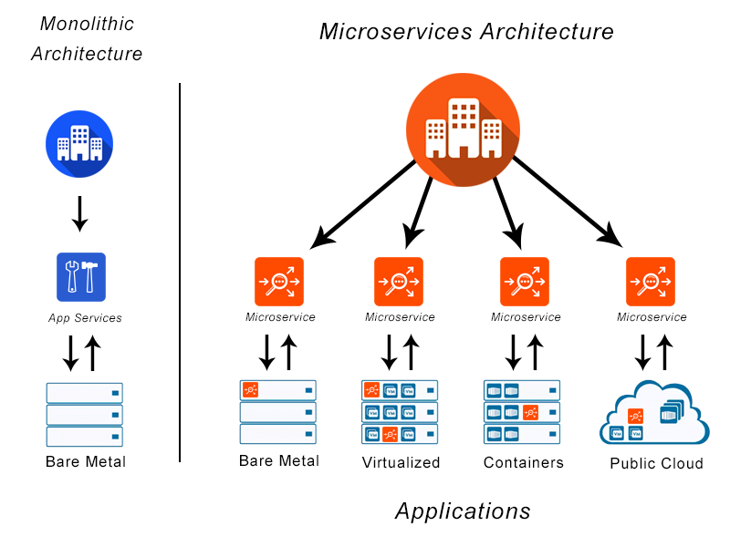
Microservices: Definition
How did We Come to Microservices?
Microservices is an architectural design for building a distributed application using containers.
Microservice gets its name because each function of the application operates as an independent service.
This architecture allows for each service to scale or update without disrupting other services in the application.
A Microservices framework creates a massively scalable and distributed system, which avoids the bottlenecks of a central database and improves business capabilities, such as enabling continuous delivery/deployment applications and modernizing the technology stack.
Source: https://avinetworks.com/glossary/microservice/

Slide 42
Characteristics of Microservices
How did We Come to Microservices?
We cannot say that there is a formal definition of the Microservices architectural style, but we can attempt to describe what we see as common characteristics for architectures that fit the label.
As with any definition that outlines common characteristics, not all Microservice architectures have all the characteristics, but we do expect that most Microservice architectures exhibit most characteristics.
Characteristics of Microservices
Componentization via services
Organized around business capabilities
Smart endpoints and dumb pipes
Products not projects
Decentralized governance
Decentralized data management
Infrastructure automation
Design for failure

Slide 43
Journey Goals

Slide 44
Goals Of Microservices Journey
Independent Development
Independent Deployment
Independent Scalability
Isolated Teams
Eventually Consistent
Fast feature rollout
Greater Time to market
Faster feature rollout
Least impact on the whole application
Greater Time to Market
Isolated Scaling
Focussed Scaling
Independent cross functional teams
Eliminate wasteful coordination meetings
Decentralized governance
Eventually consistent transactions
Eventually consistent microservices state
Business Driven
Technical separation matches domain separation
Overall separation also matches clear independent stakeholders
Build MVP quickly
Evolutionary Architecture
Architecture evolves as much as possible over time
Design for replacement(not re-use!)
Minimal shared dependencies
Autonomy
Pragmatic

Slide 45
Goals Of Microservices Journey
Cohesive and Decoupled Services
Self Contained Systems
NOT a distributed monolith
NOT a system made up of arbitrary sized, tightly coupled services communicating over network interfaces.
Hype-Driven
Encapsulate Domain
Should be reflection of domain, instead of mere entity CRUDs
Slice across all layers
Services and UI should be treated as a microservice
Micro-frontends
Isolate Everything
No front-end Monoliths
Time | Space | State | Failure | Teams | Services | Deployment | Development | Delivery | Scaling | Testing | Hardware
High Observability
Logging
Monitoring
Tracing

Slide 46
Microservices Complexities and Challenges

Slide 47
Challenges with Microservices
How did We Come to Microservices?
Complexity has moved out of the application, but into the operations layer
Fallacies of Distributed Computing
Services may be unavailable
Never needed to worry about this in a monolith!
Design for failure, circuit breakers: “Everything fails all the time” - Werner Vogels, CTO Amazon
Much more monitoring needed
Remote calls more expensive than in-process calls

Slide 48
Challenges with Microservices (continued)
How did We Come to Microservices?
Transactions must rely on eventual consistency over ACID
Features span multiple services
Change Management becomes a different challenge
Need to consider the interaction of services
Dependency management/versions
Refactoring module boundaries

Slide 49
Fallacies of Distributed Computing
How did We Come to Microservices?
The network is reliable.
Latency is zero.
Bandwidth is infinite.
The network is secure.
Topology does not change.
There is one administrator.
Transport cost is zero.
The network is homogeneous.

Slide 50
Modularity and Distribution

Slide 51
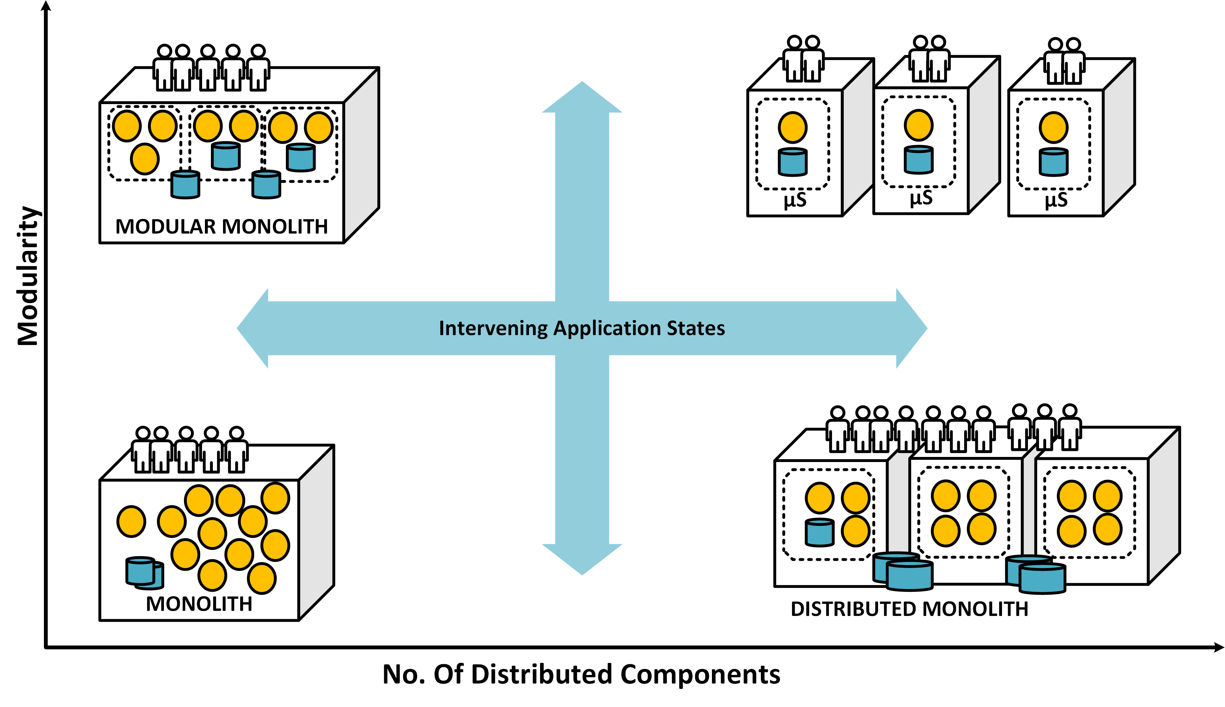
Journey At a Glance – Somewhere in between

Slide 52
Service Decomposition – Which services first ?
Team Structure
Splitting teams with support from dedicated team is easier.
Fast Changing Services
Services that have large pace of change should be split early to avoid piling up changes for a complex migration later.
Services with Major Business value
Services that form the core focus of business(read money), should be enabled for isolated deployment, release & scalability.
Database
The most complex dependency to solve.
Services that would mean clean separation of database are golden and should be found early.
Other Factors
Data Security(GDPR, HIPPA, and so on)
Monitoring and observability need
Canary type requirement
Simplicity
Simple Untangled services are easiest to manage.
Play it Safe.
Technical Debt
Services with least technical debt are good candidates since they don’t bring the debt to microservices as well.
The services with least entanglement of dependencies with rest of services are easy to separate out.
Test Coverage
Services with good test coverage( preferably automated) would provide more confidence during migration.

Slide 53
How Micro is Micro?
How did We Come to Microservices?
Code lines/bytes is not the compelling factor
Size of scope
Small enough for an individual developer to digest
Small enough to be built and managed by small team
Amazon’s 2-pizza rule
Documentation small enough to read and understand
Social Security Act of 1935 – 63 pages
Affordable Care Act of 2010 – 906 pages
Dozens of secrets, not hundreds
Predictable; Easy to experiment with

Slide 54
Discussions

Slide 55

Discussion
How did We Come to Microservices?
Which of the pros/cons of Microservices are most applicable in your situation?
What are some potential services in your application?

Slide 56
Discussion
How did We Come to Microservices?
An organization has decided to restructure an existing large monolith into Microservices.
The plan calls for separate teams to develop the services, such as:
Mobile developers/testers for the mobile app
Web developers/testers for the webpages
A team of Java/Spring developers to do the controller layer
A middleware team of Java/Spring developers building the service layer
Several small teams specialized on back-end persistence services: Oracle, Mongo, Redis, and Amazon S3
Do you have any thoughts on this plan?

Slide 57
Discussion
How did We Come to Microservices?
A small development team is considering switching to a Microservices architecture.
Their application takes mobile surveys. A mobile app queries the backend for the survey and presents it to the user. When the user votes, the mobile app sends the vote to the backend, which records the vote on one DB table, and a tally of all votes for the survey on another table. The mobile app then queries the backend for the tally.
The team consists of two people - a mobile developer and a backend/DB developer.
Do you have any advice?

